Slide 1
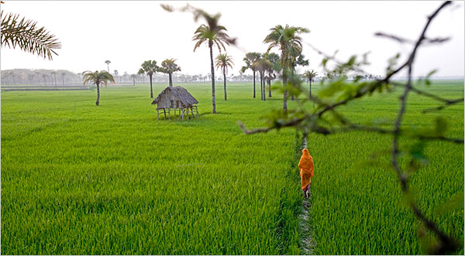
Welcome

Slide 2


Introduction
Selina Akter
Ass.teacher
Bohoddar kaTa High School
Chakaria,Cox’s Bazar
E-mail: selikamal8485@gmail.com
Mobile:01815851776

Slide 3

Introduction of Class & Subject
Class-VIII Subject: English First Paper Time: 45 Minutes

Slide 4
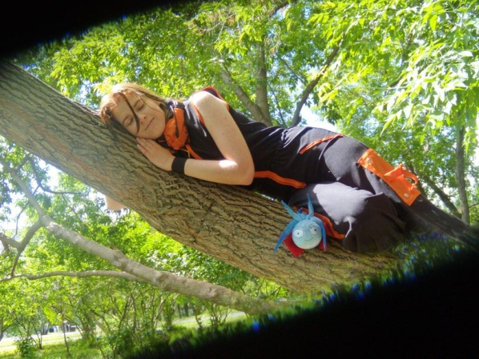
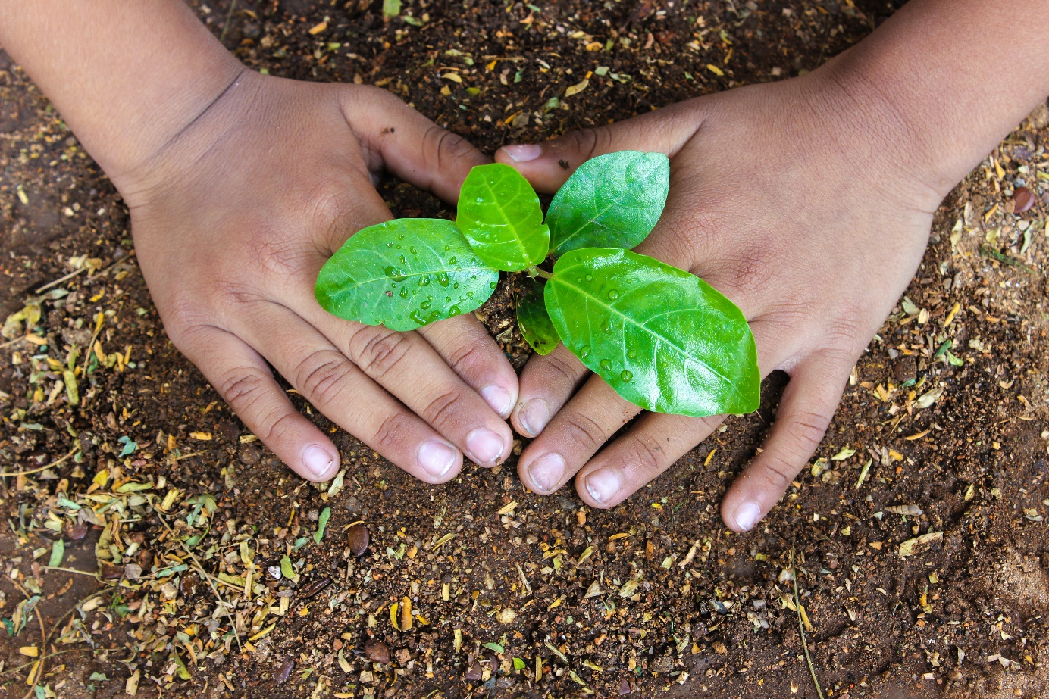
Lets see some pictures-
sleeping on the tree.
Planting trees.
Tree lovers
They all are-

Slide 5
Our Today’s Lesson is-
A Man Who Loves Tree
Unit-5, Lesson-4

Slide 6
Learning outcomes
At the end of the lesson we will be able to learn-
ask and answer questions.
read and understand text through silent reading.
infer meaning from context.
write answer to questions.

Slide 7

Let us introduce with some new words/key words.
Profession
Occupation, job, business
She is a doctor by profession.

Slide 8
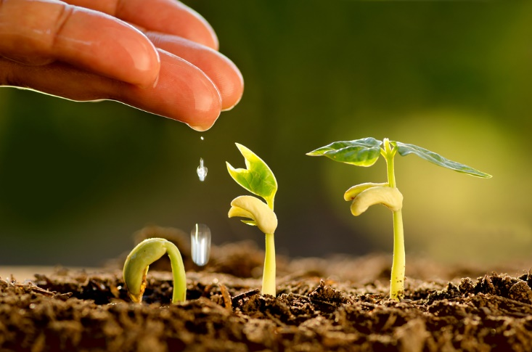
Sapling
Meaning: Seedling, plantlet, sprig
Anika used to plant sapling.

Slide 9

Mission
Meaning: operation, target
No vision is succeeded without a mission.

Slide 10
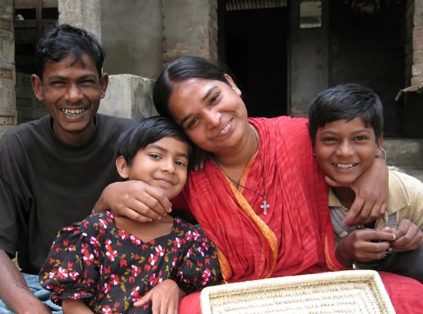
Passion
Meaning: Desire, love
Passion is oxygen of the soul.

Slide 11
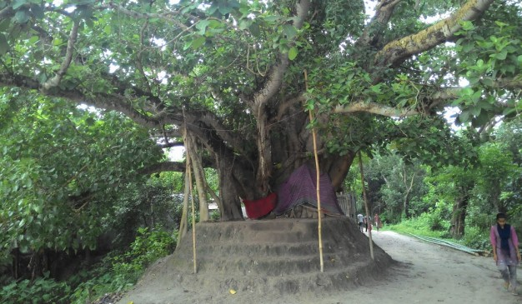
Gigantic
Meaning: Huge, large
What a gigantic tree it is!

Slide 12
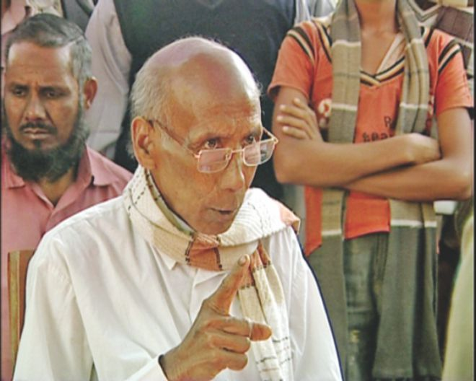
Do you know this person?
Kartik Poramanik

Slide 13
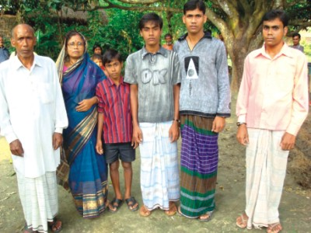
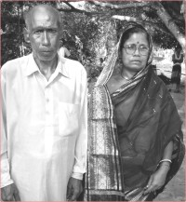
Let us introduce with him.
Name : Kartik Poramanik
Father : Suren Poramanik
Mother : Subas Bala
Village : Tarapur
Upazilla : Shibgonj
Dist. : Chapainawabgonj
Birth Year : 1942
Profession : Hair dresser
Passion : Planting trees
Identity : Nature lover.

Slide 14


Single work
How do you understand that Kartik Poramanik is a nature lover ?

Slide 15
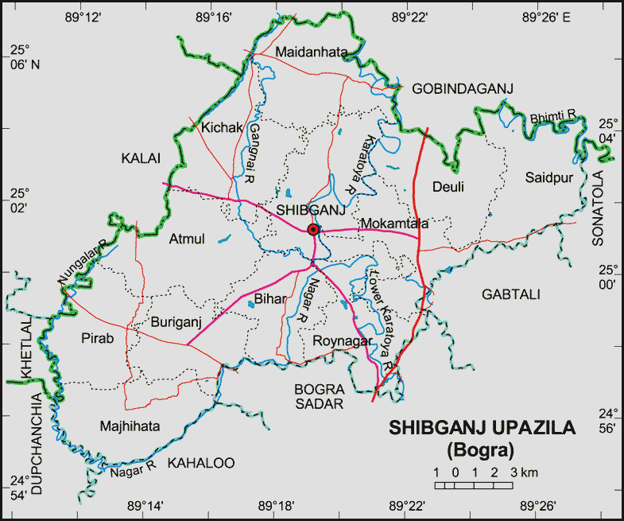
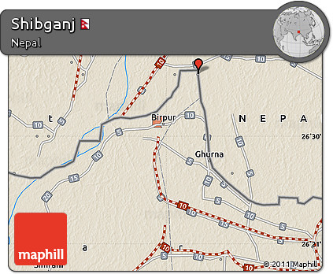
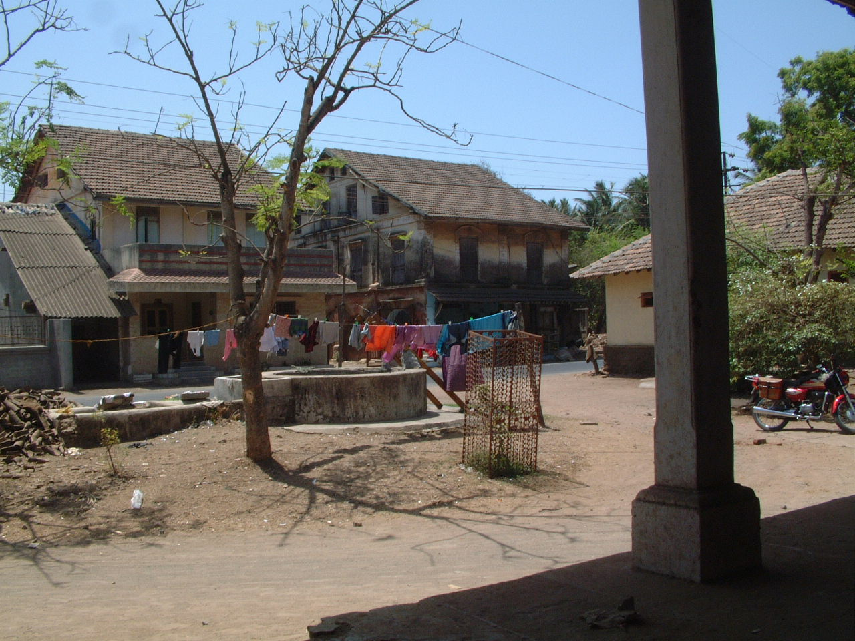
A village of-
Tarapur

Slide 16
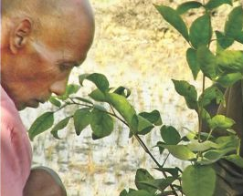
Kartik Poramanik lives in this village.

Slide 17
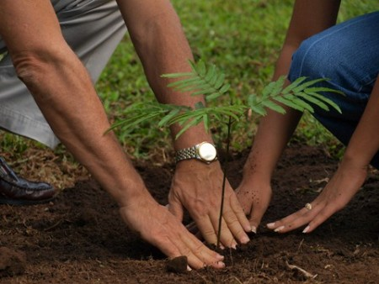
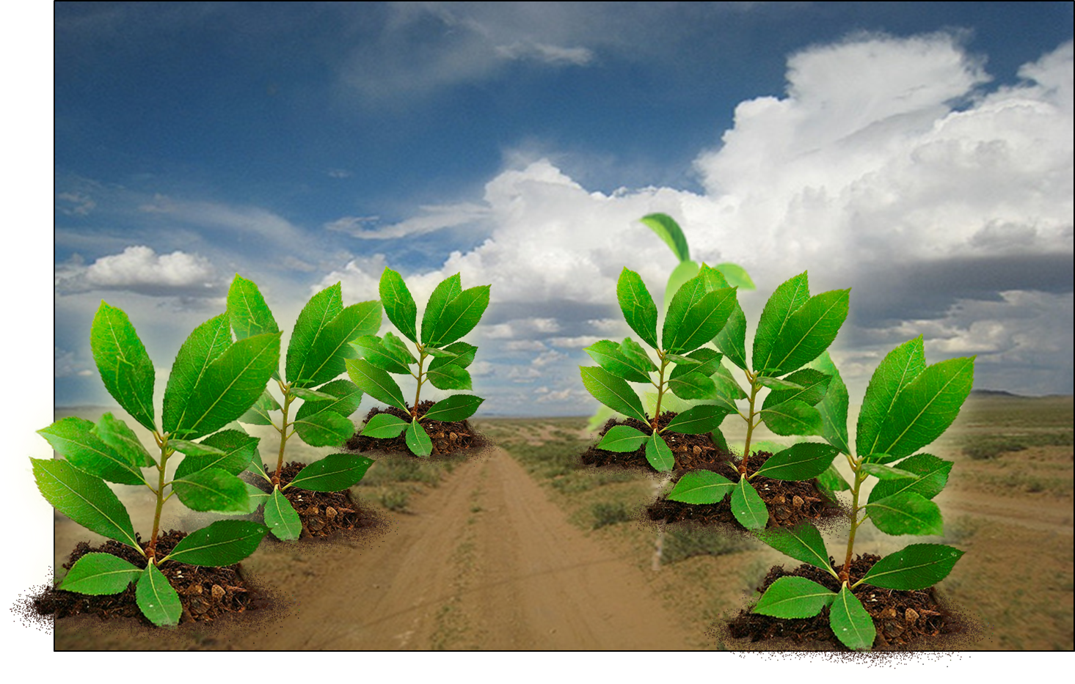
His passion is to plant sapling.
His tree planting mission at the age of ten.

Slide 18
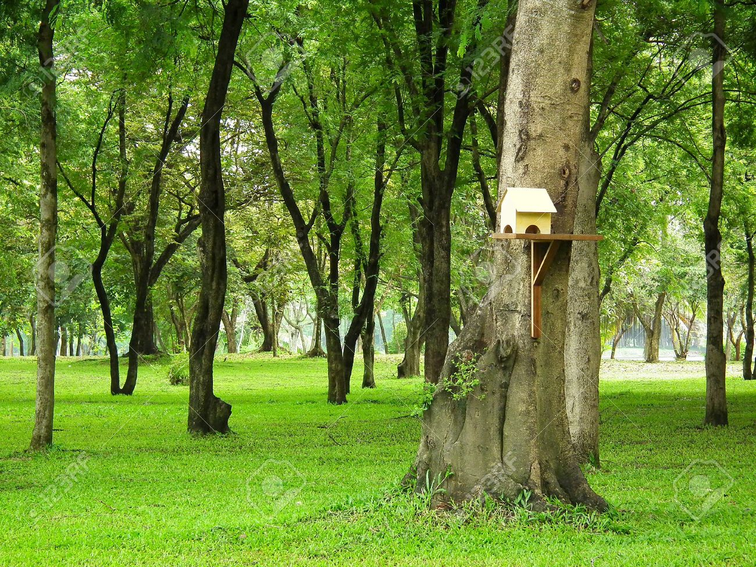
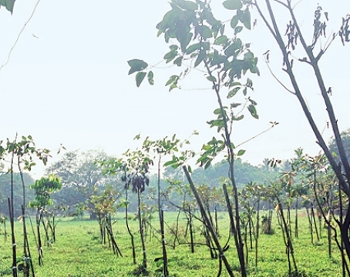
Many of the trees are now 35-40 years old.
He has planted hundreds of trees in his village.

Slide 19
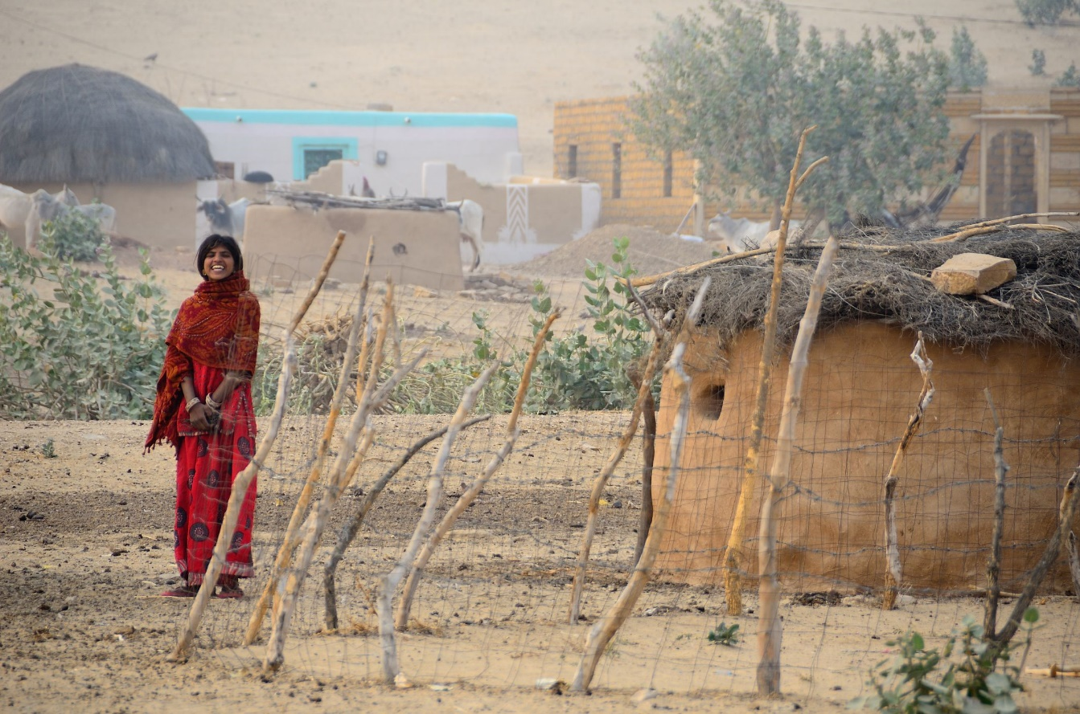
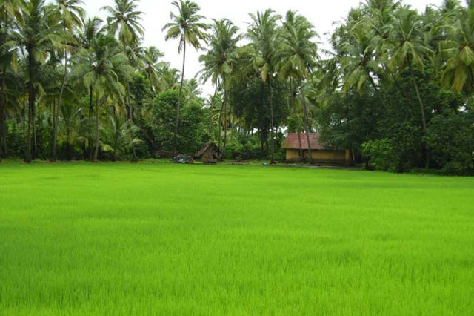
Before 72 years Tarapur was like
Present Tarapur
Without tree
Green Tarapur

Slide 20
Now let us know the rest of his story by silent reading from the text book-
Kartik would wake up early in the morning, take one or two labourers with him and set out to plant trees. He would walk long distances to plant trees, carrying with him some dry food and water. He would pay all the expenses from his own pocket. Kartik has planted trees beside the roads, in and round the bazar, schools and colleges, open fields and many other places. At times it so happened that Kartik would go to water his plants at 10 or 11 p m. People asked him, "Kartik, are you mad? What are you doing so late at night?" Kartik would smile and say, "What to do, sir. I have to work hard the whole day to earn money for my family. I don't get time during the day. But my trees would die if I don't water them. So I come late at night to look after them.“ Even today this old man continues planting trees as many as he can. A man, who can hardly sign his name, is leaving his signature all around in nature.

Slide 21

Group work
B True or false? If false give the correct information.
  1 He planted the first tree 50 years ago.
  2 Katrik borrowed money from others to plant trees.
  3 He would plant trees around his hut only.
  4 At times Kartik would water his trees at night because he felt lazy during the day.

Slide 22
Evaluation
C Choose the best answer.
1 Karik was a …………… by profession.
a cultivator
b tree planter
c day labourer
d hair dresser
2 His mission is to make the village green by………
  a cultivating paddy in the fields.
  b growing grass in all the fallow land.
  c planting fodder for the cattle.
  d planting many trees.

Slide 23
Evaluation
3 Some of Kartik’s trees are big and …………….
  a great.
  b gigantic.
  c enormous.
  d kingly.
4 Some of his trees are…………… years old.
  a 15 - 20
  b 25 - 35
  c 35 - 40
  d 40

Slide 24

Home Work
D Read the text again and answer the following questions.
1 Who is Kartik Poramanik?
2 How do you understand that he is a nature lover?
3 Why did he plant trees?
4 What do you understand by the saying: “A man, who can hardly sign his name, is leaving his signature all around in nature?”

Slide 25
Allah Hafiz

